Slide 1
VAST CHALLENGE 2024
MINI CHALLENGE 2
MEHMET EMRE SAHIN, FUNDA YILDIZ AYDIN, SINEM BILGE GÜLER

Slide 2
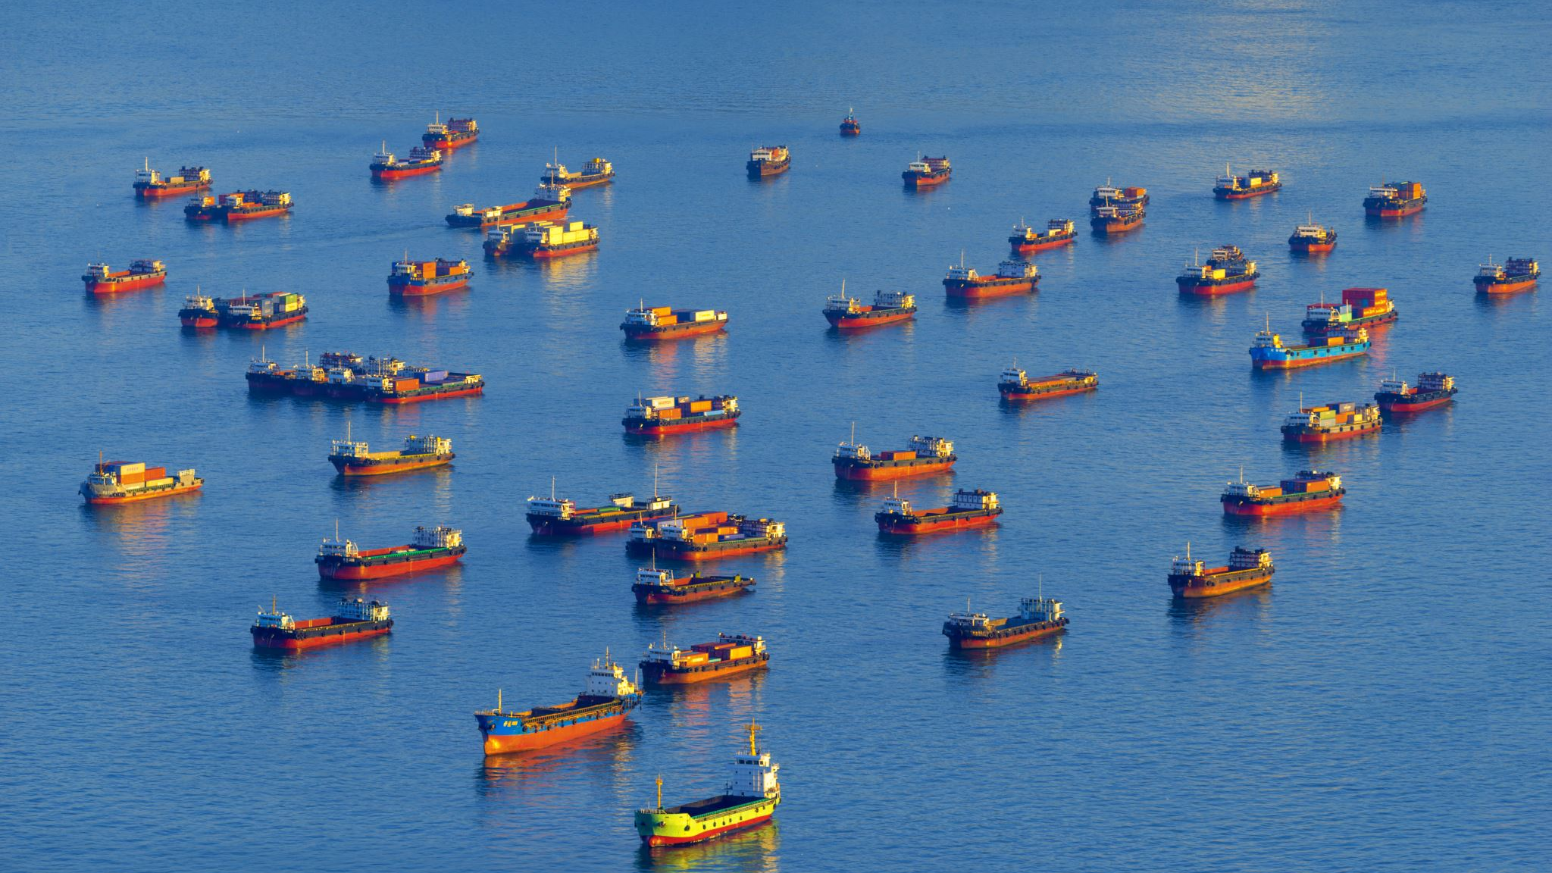
CREATING SIGNATURES FOR GEO-TEMPORAL PATTERNS
WE DON’T KNOW WHICH VESSELS DELIVERED THE PRODUCTS
WHICH VESSELS PERFORM SIMILAR BEHAVIOR TO SOUTHSEAFOODEXPRESS CORP COMPANY
ILLEGAL FISHING

Slide 3
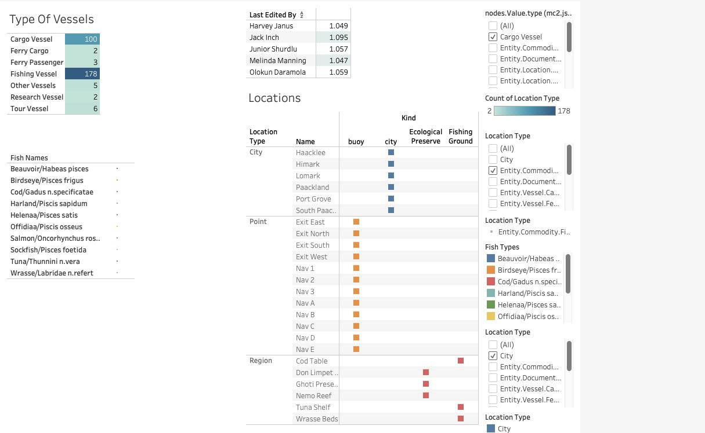
Entity.Document.DeliveryReport
doesn't exist in our locations

Slide 4
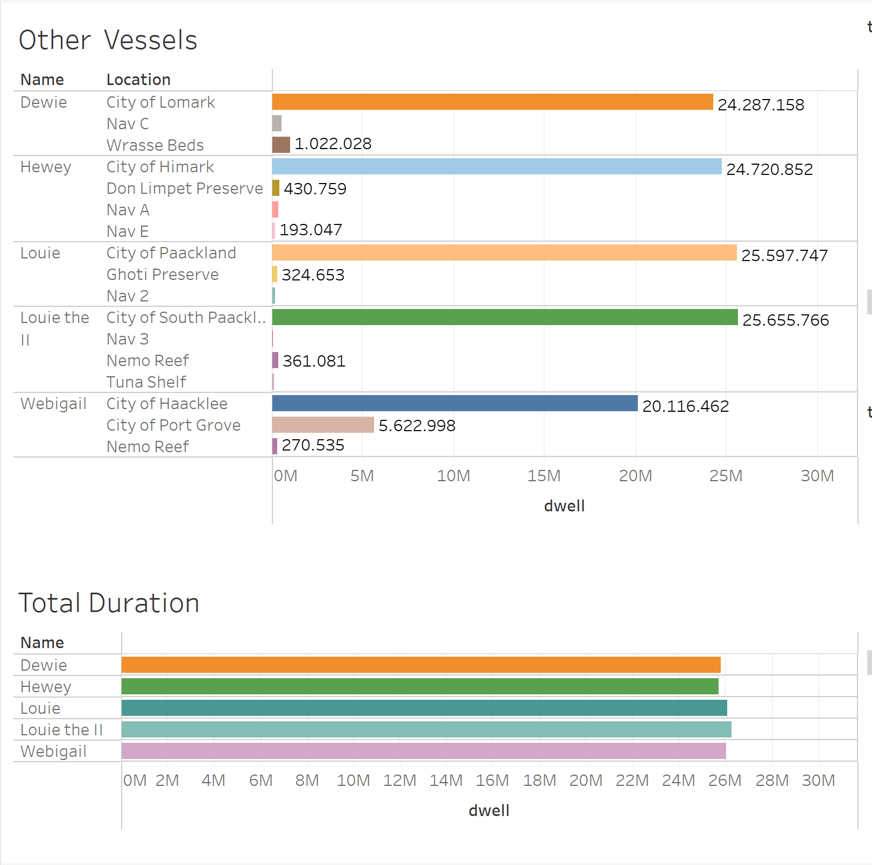

Slide 5
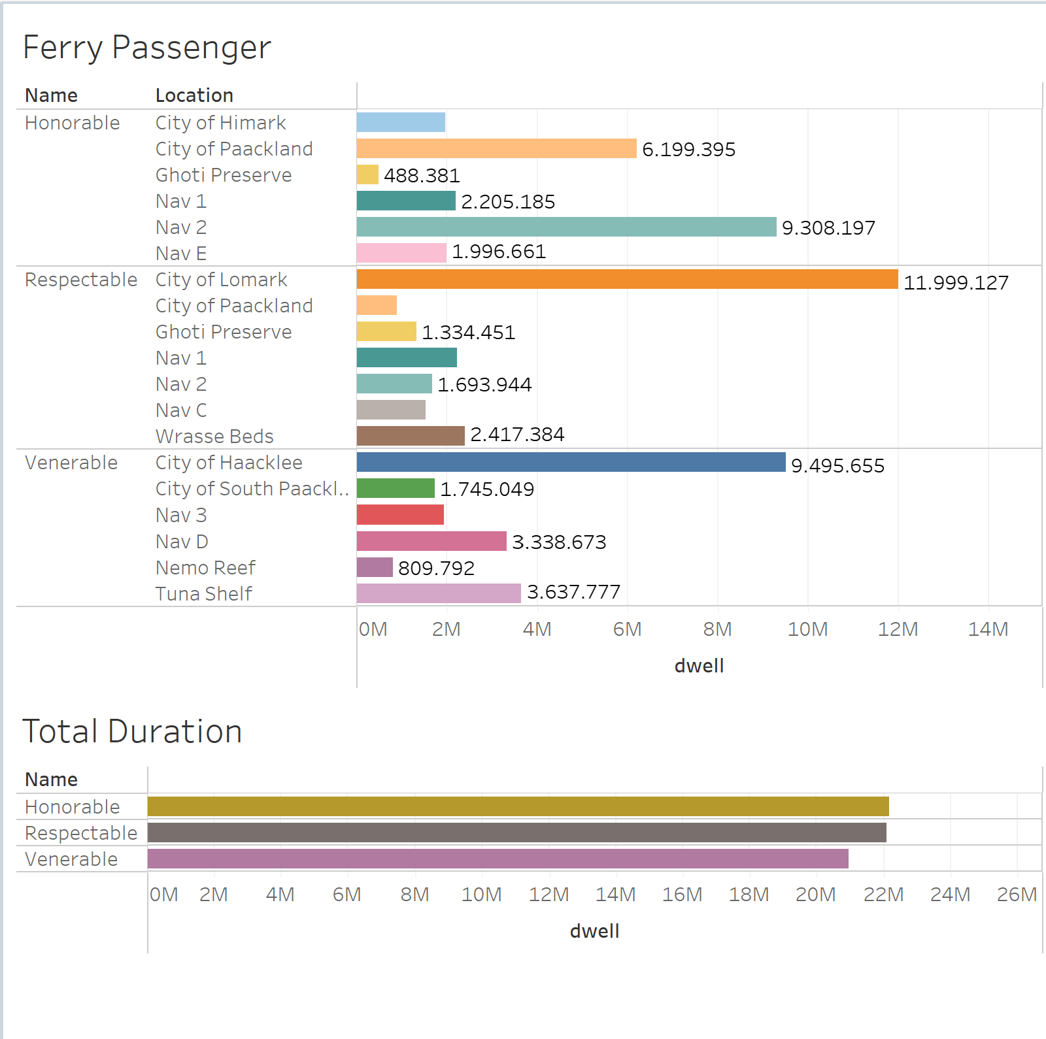

Slide 6
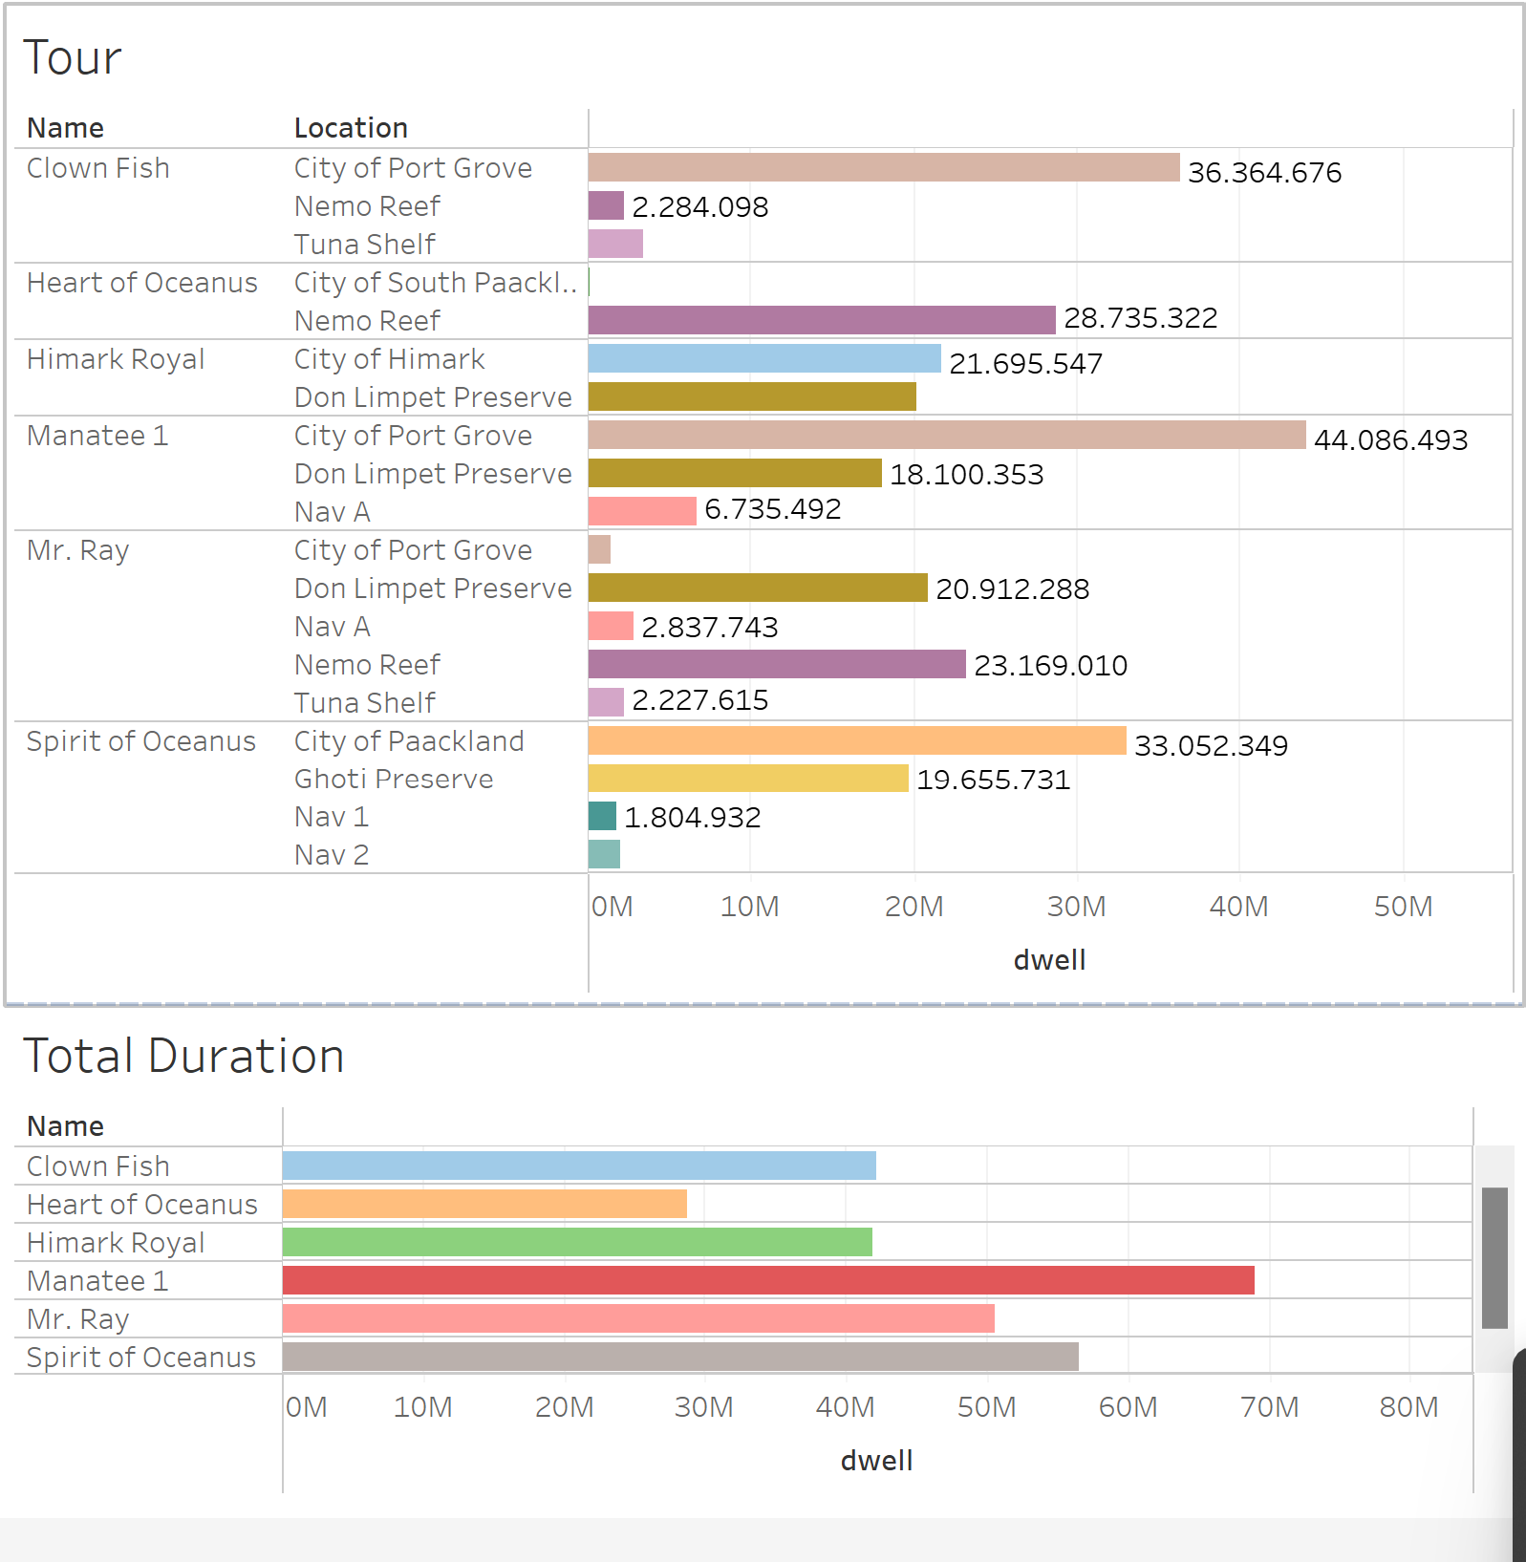

Slide 7
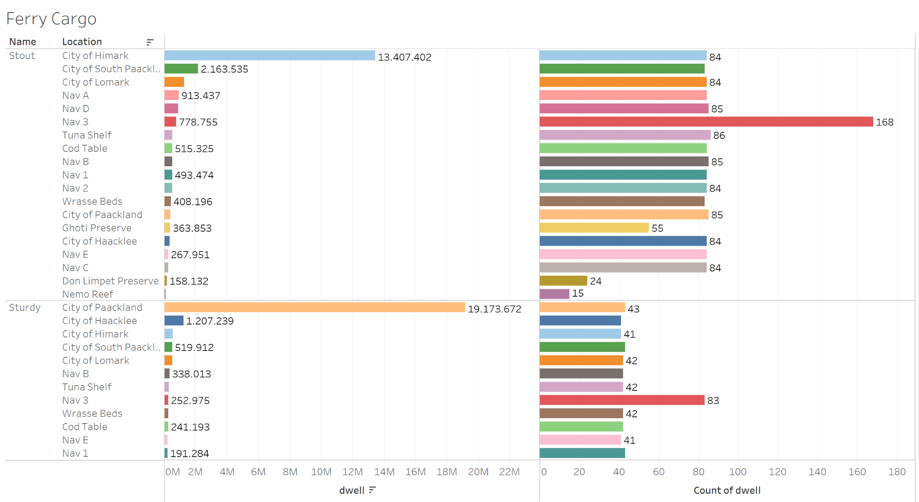

Slide 8
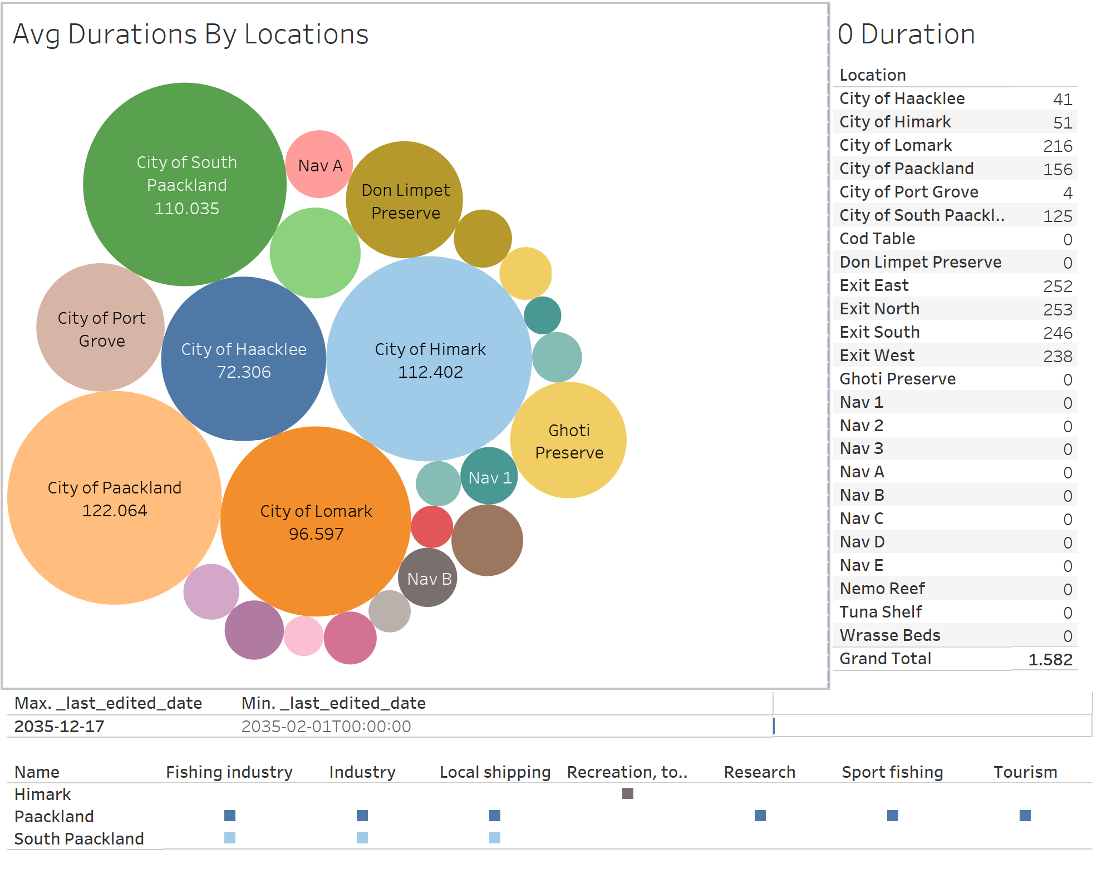

Slide 9
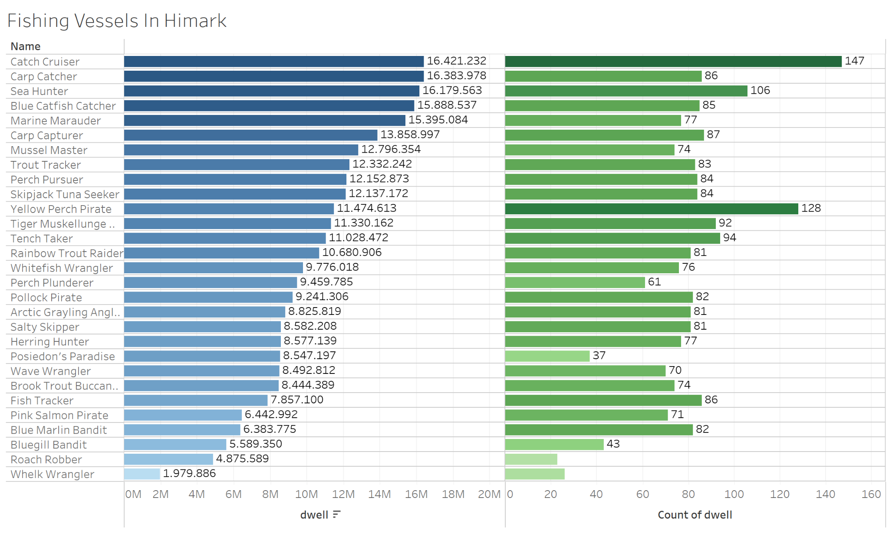

Slide 10
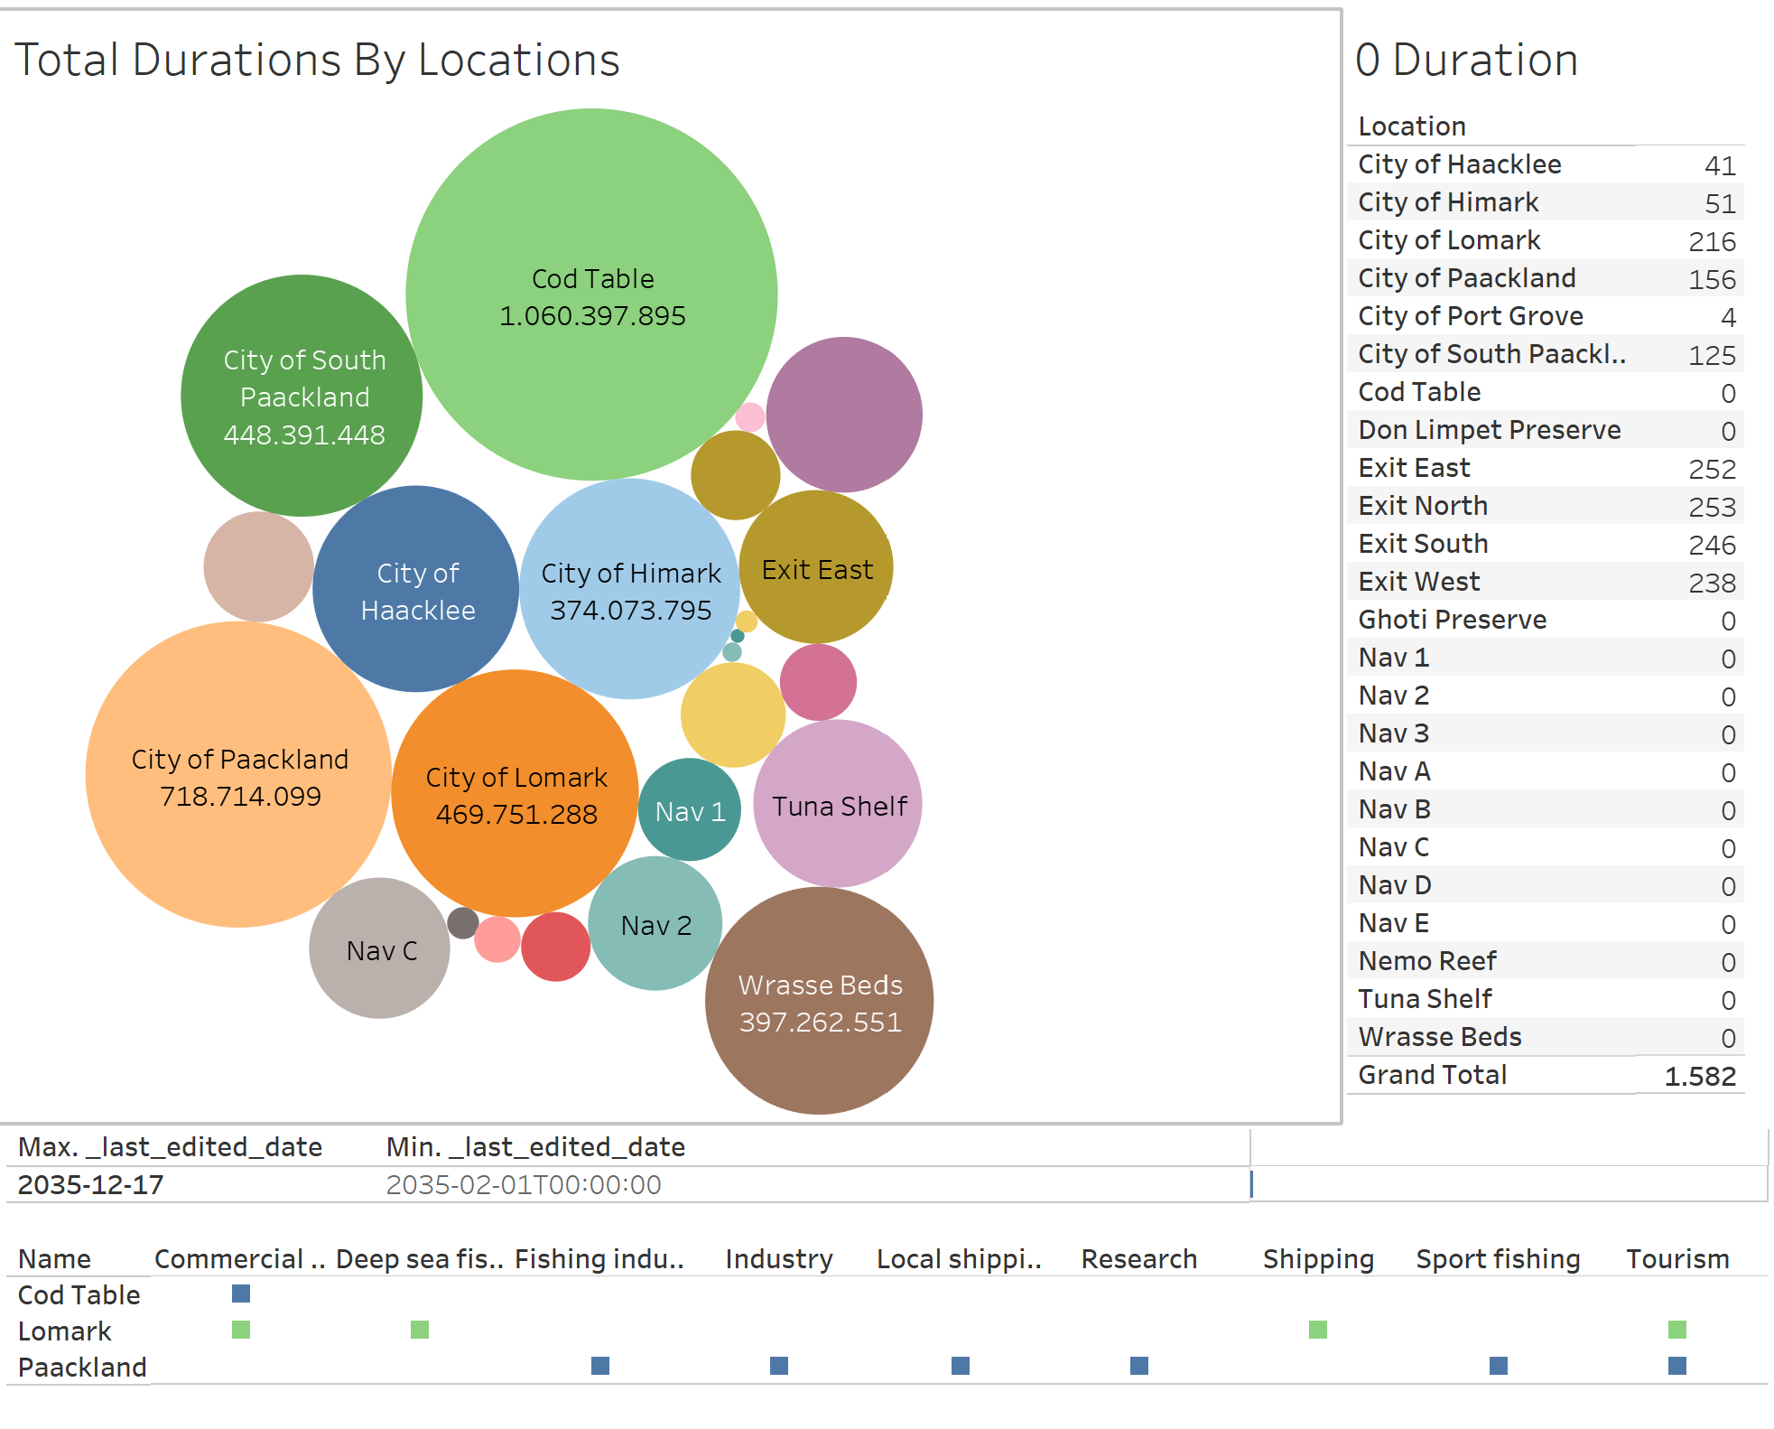

Slide 11
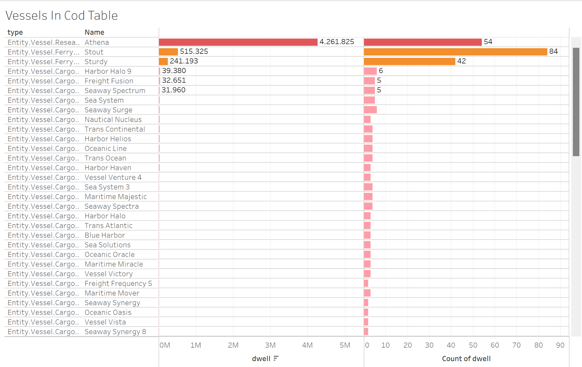

Slide 12
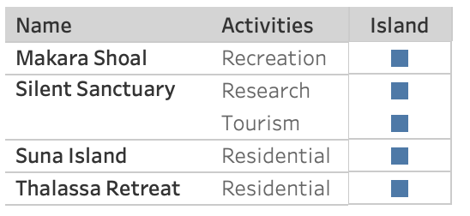
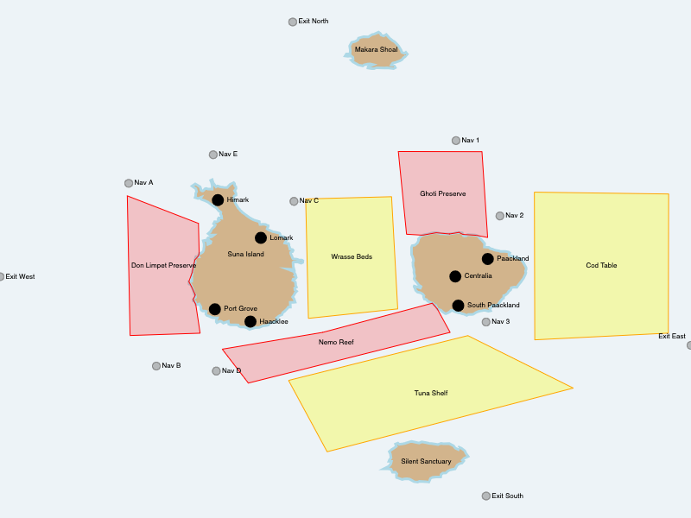
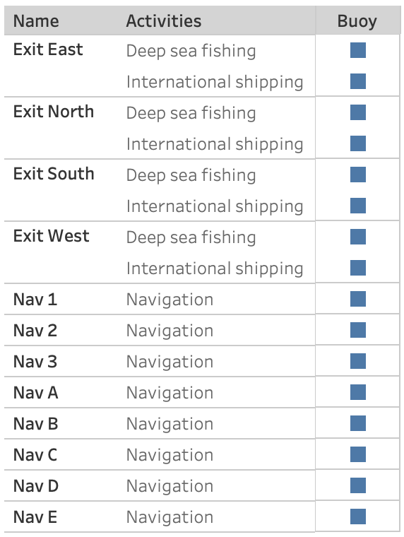
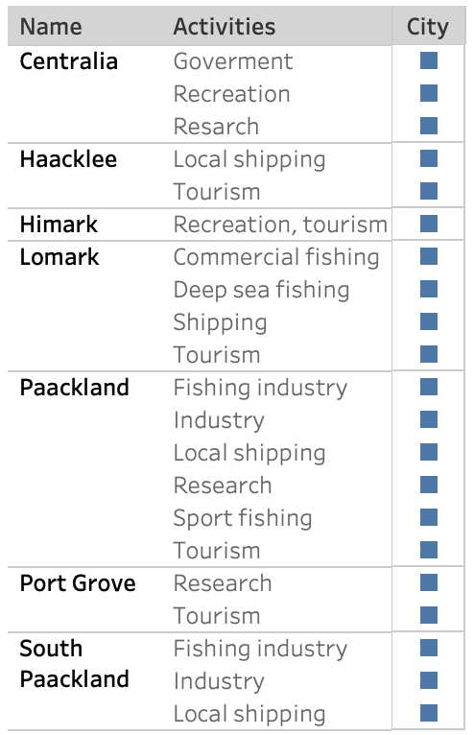
LOCATIONS

Slide 13
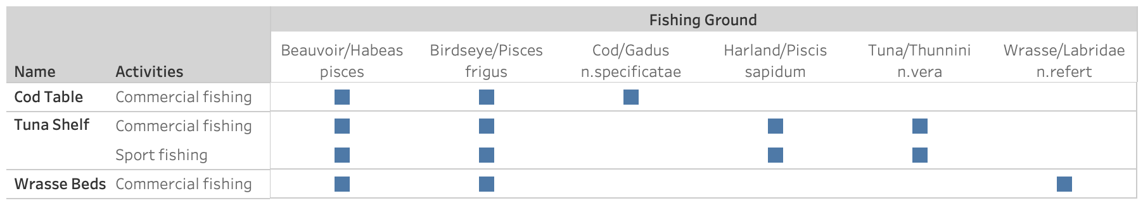
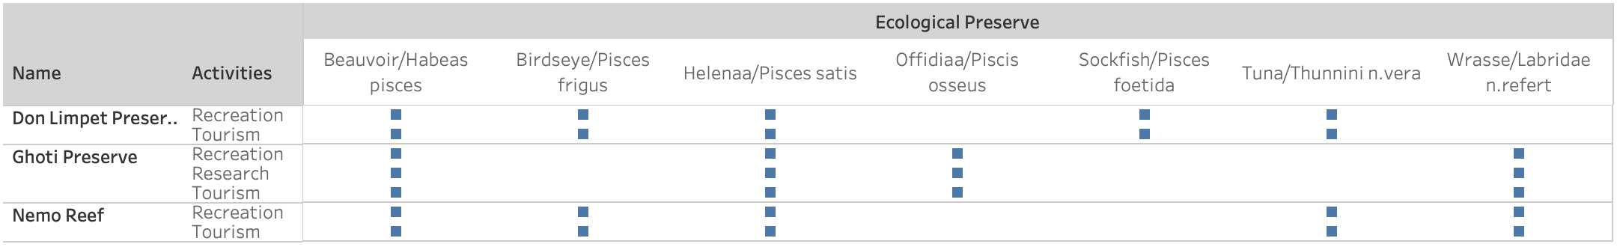
Helenaa/Pisces satis, Offidiaa/Pisces osseus, and Sockfish/Pisces foetida are not supposed to be seen in the transportation containers

Slide 14
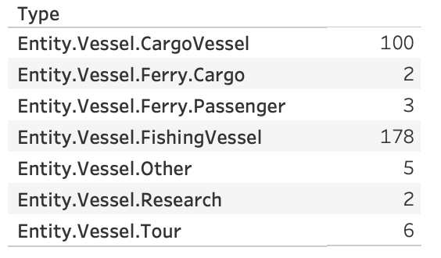
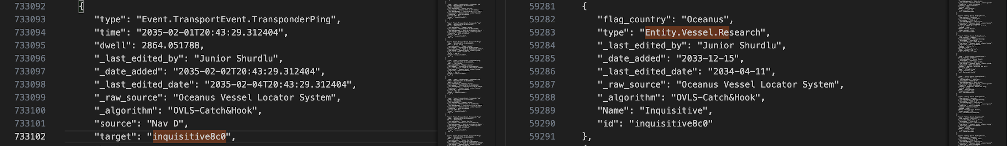
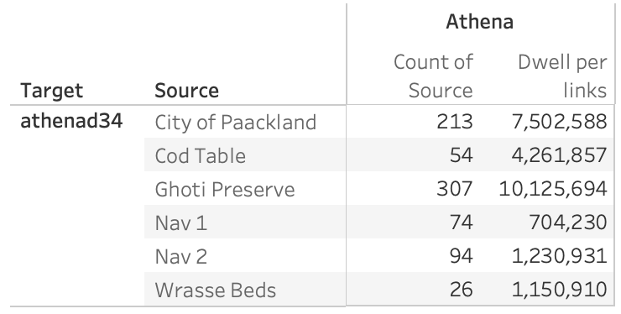
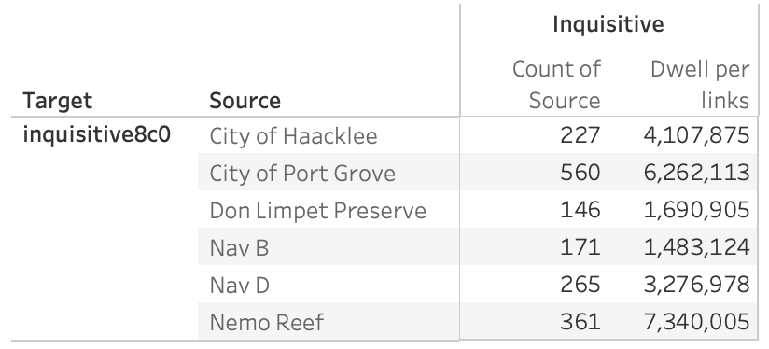
VESSELS
2 research vessels named Athena and Inquisitive.
Links Data
Nodes Data

Slide 15
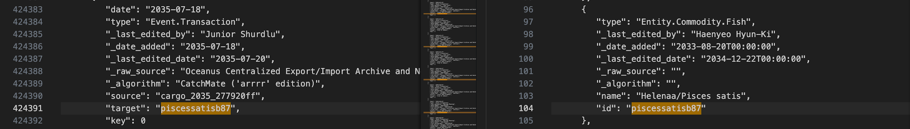
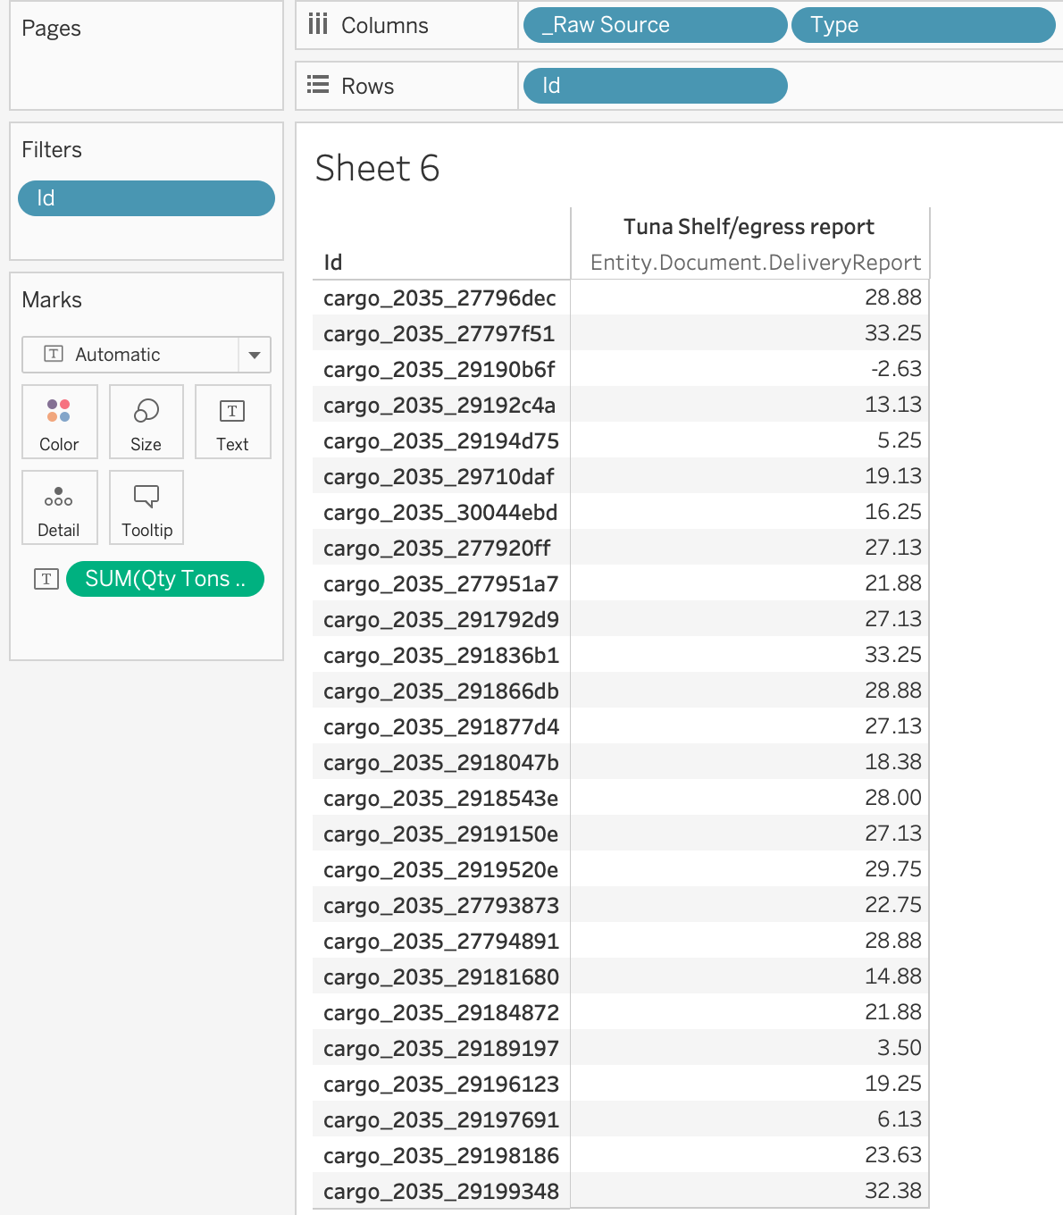
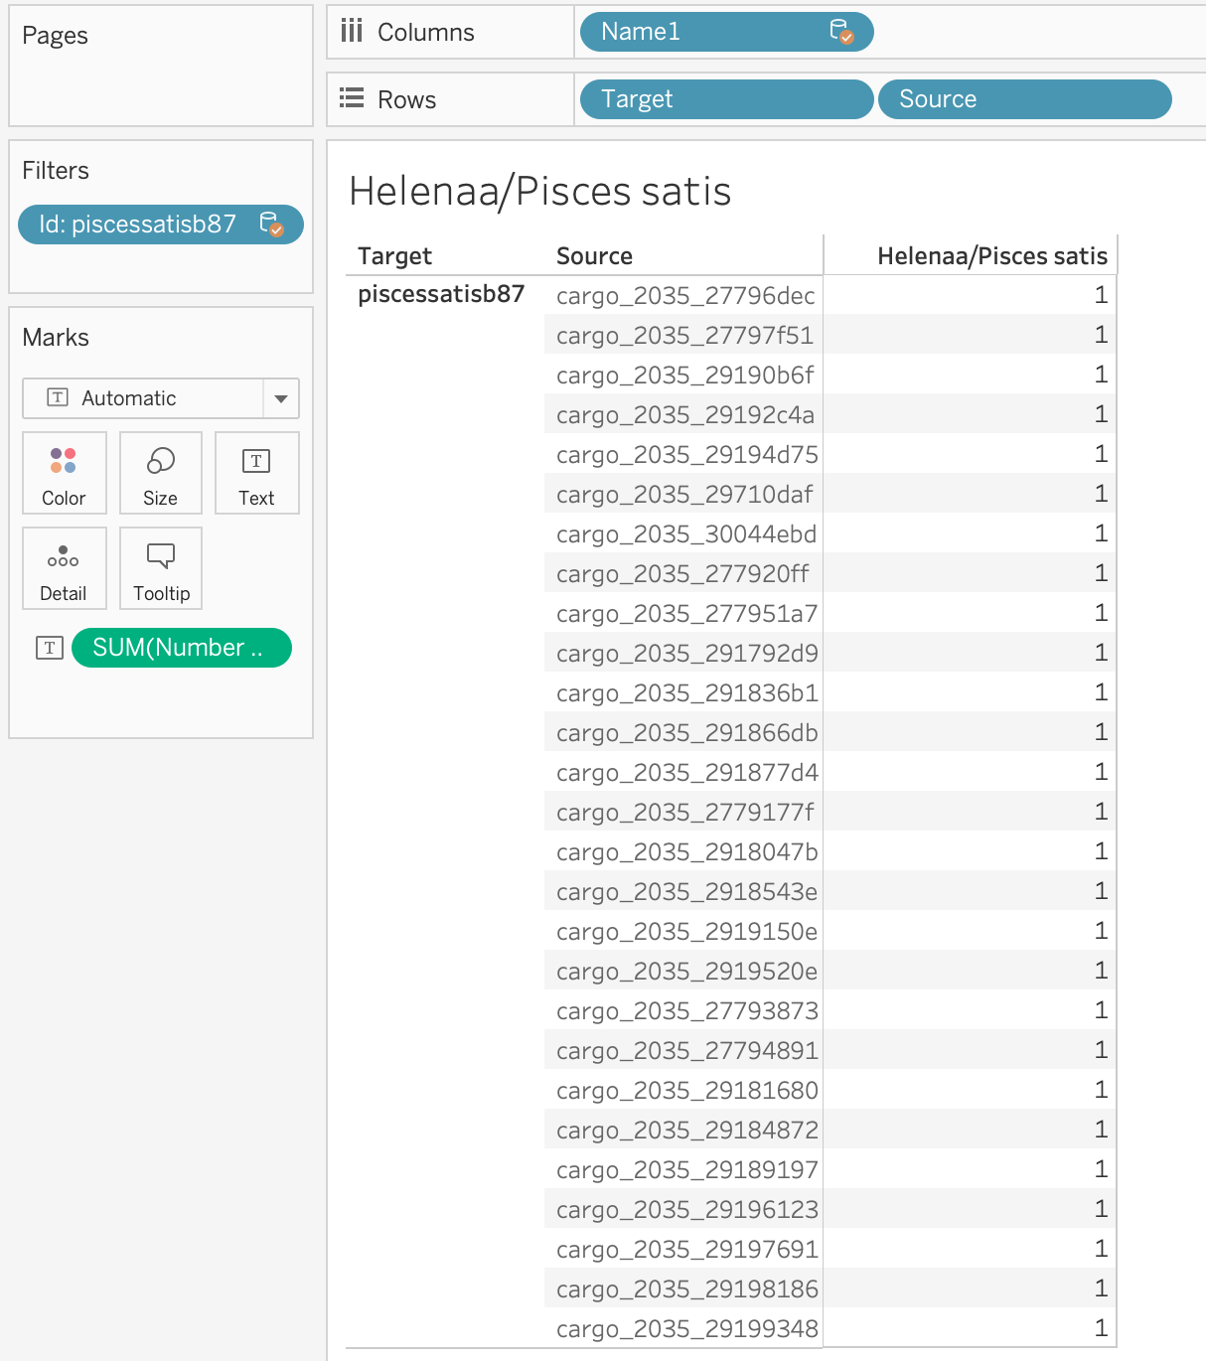
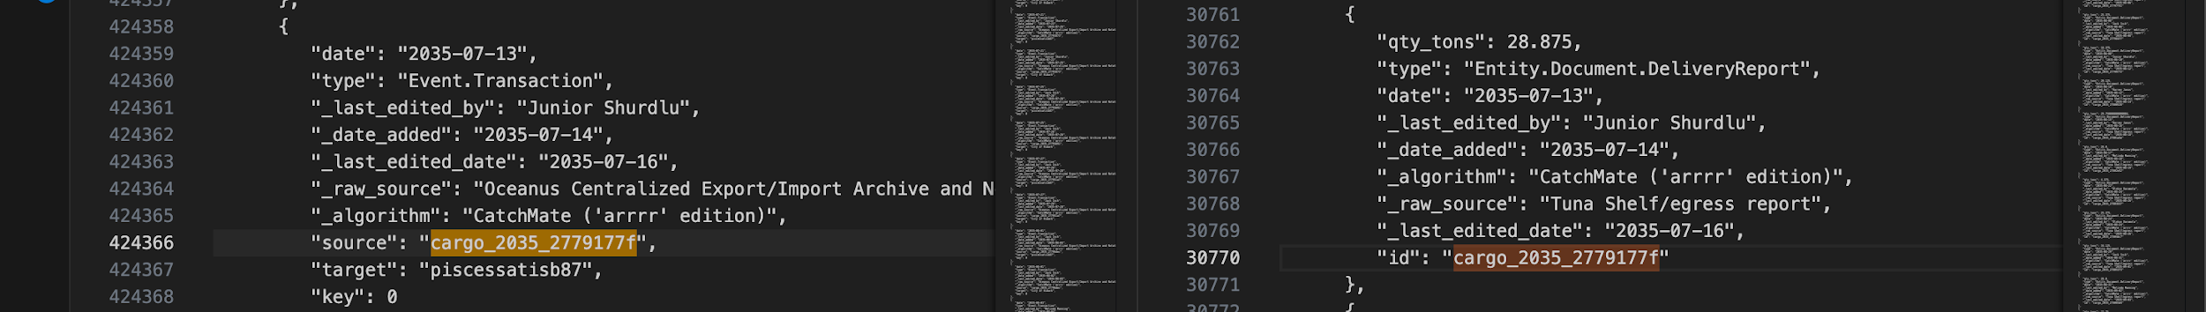
TRANSPORTATION OF FISHES

Slide 16
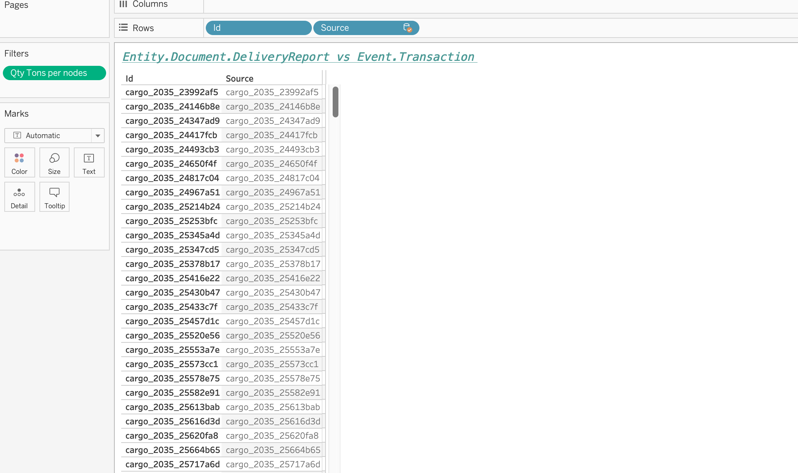
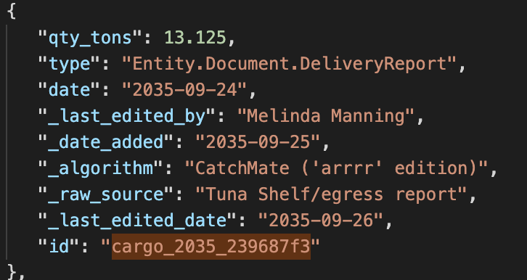
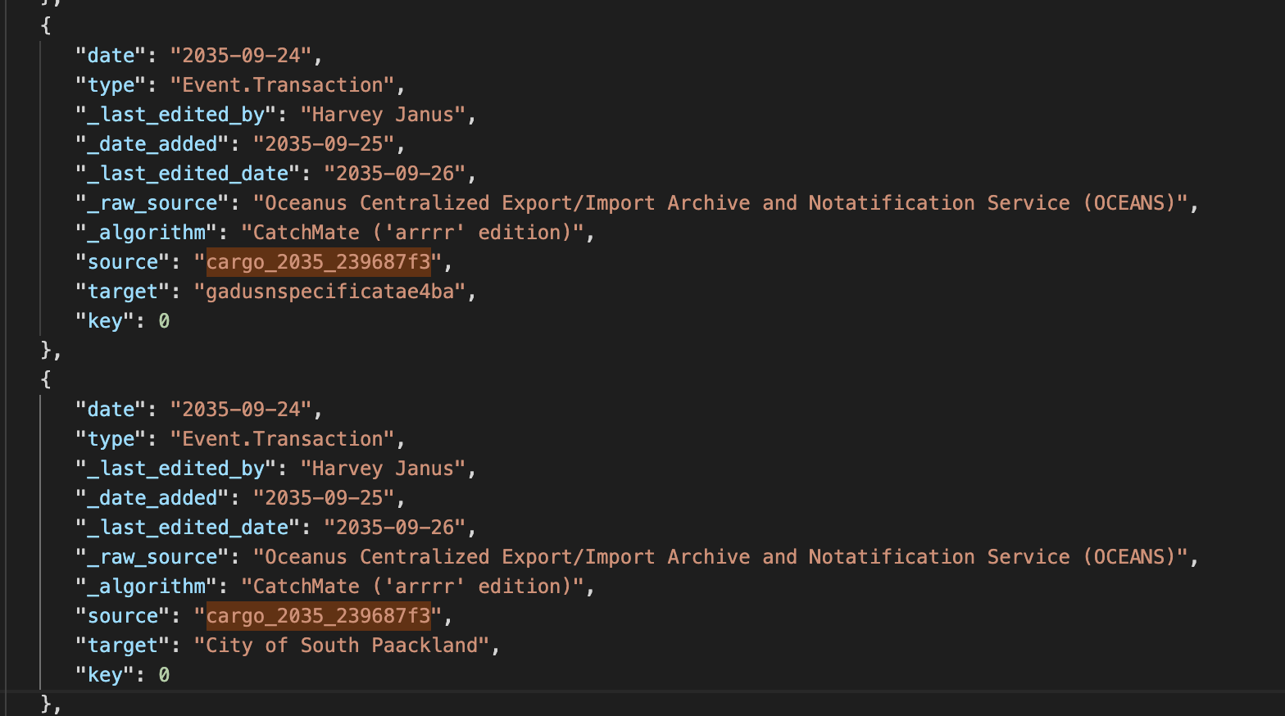
TRANSACTION AND DELIVERY REPORT

Slide 17
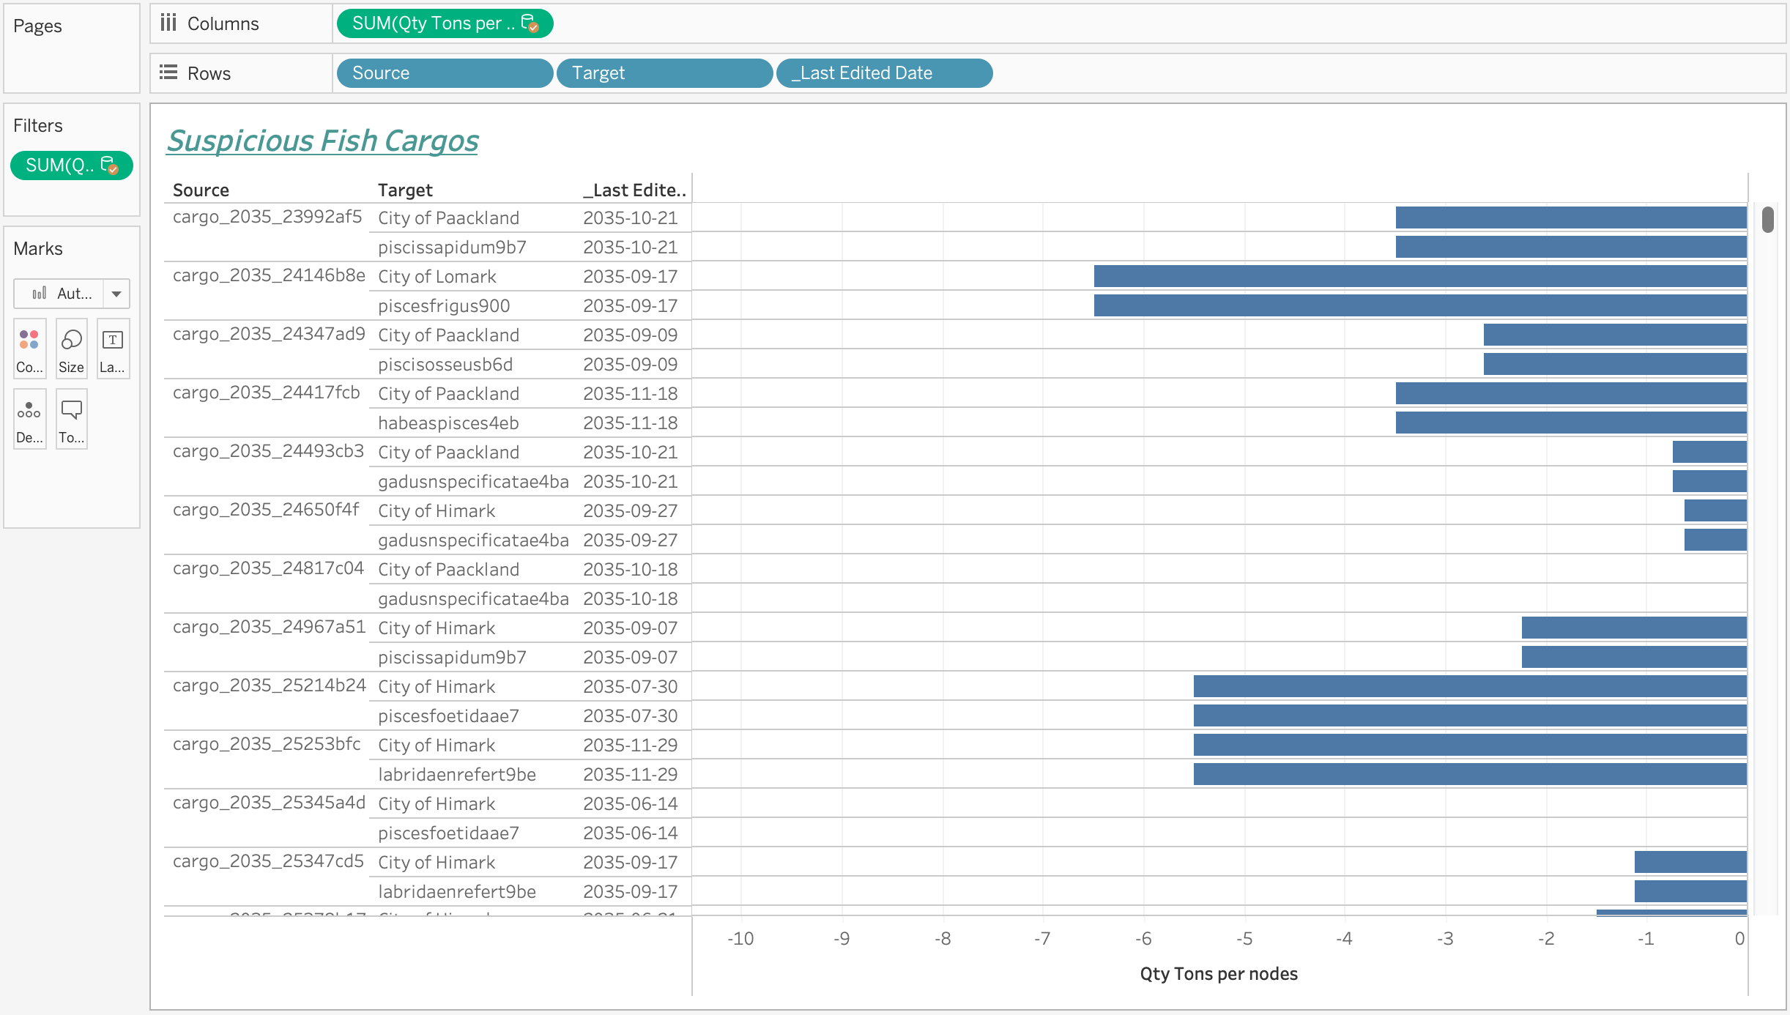
SUSPICIOUS FISH CARGOS

Slide 18
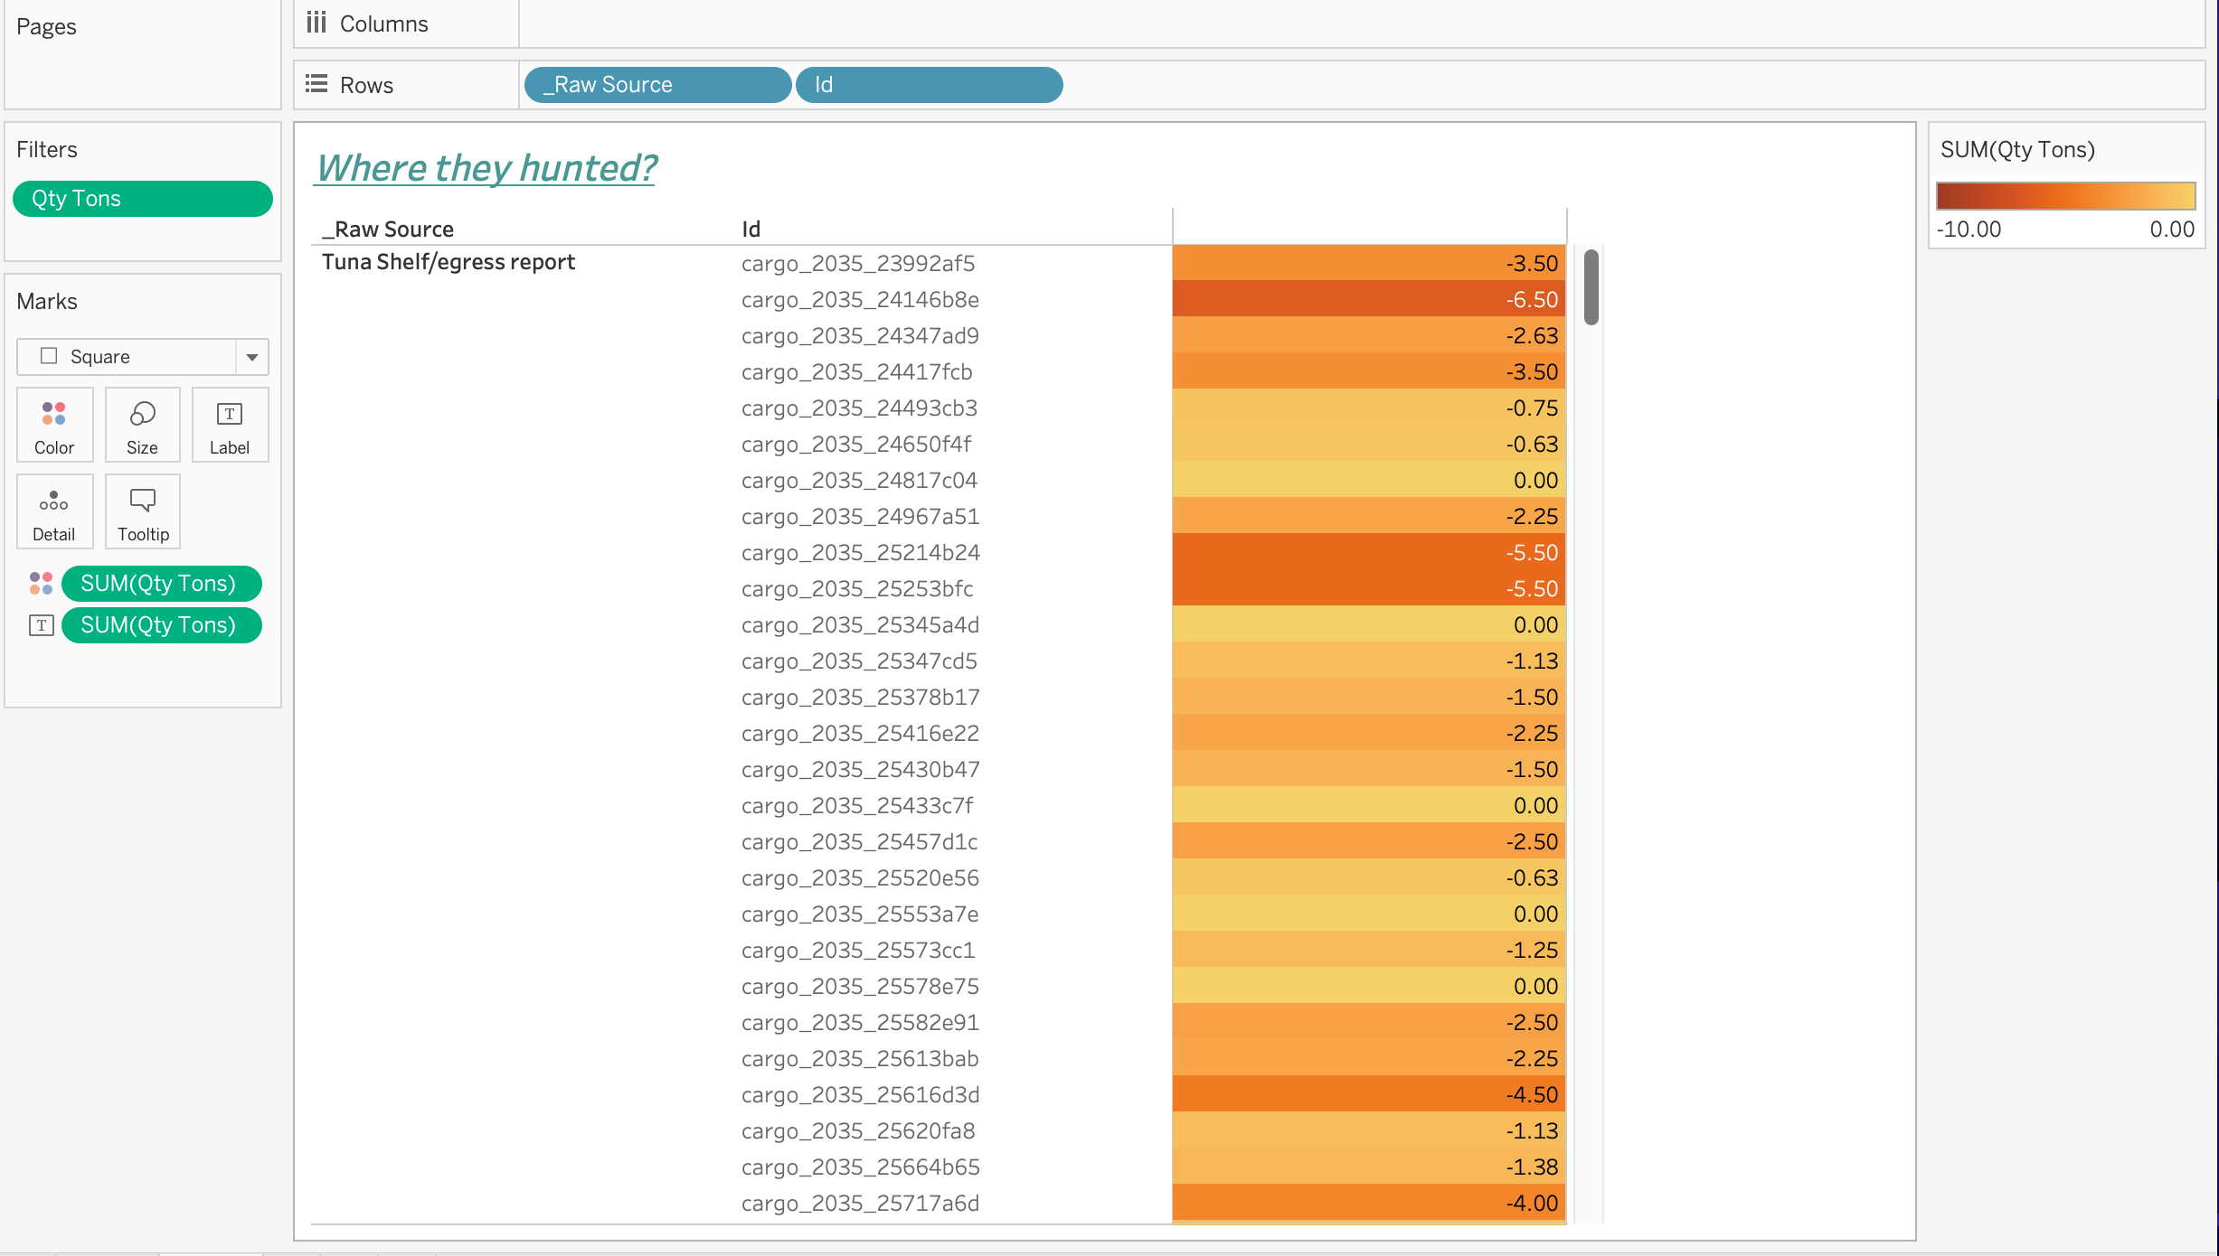
WHERE THEY HUNTED?

Slide 19
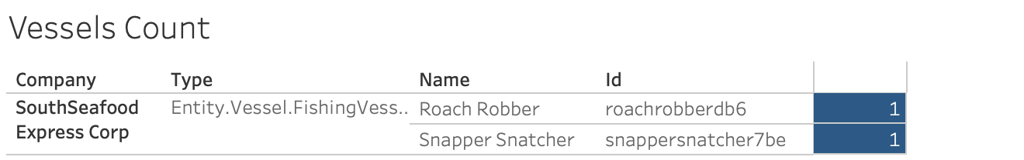
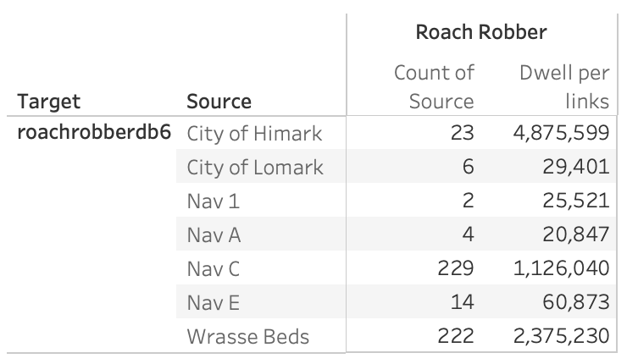
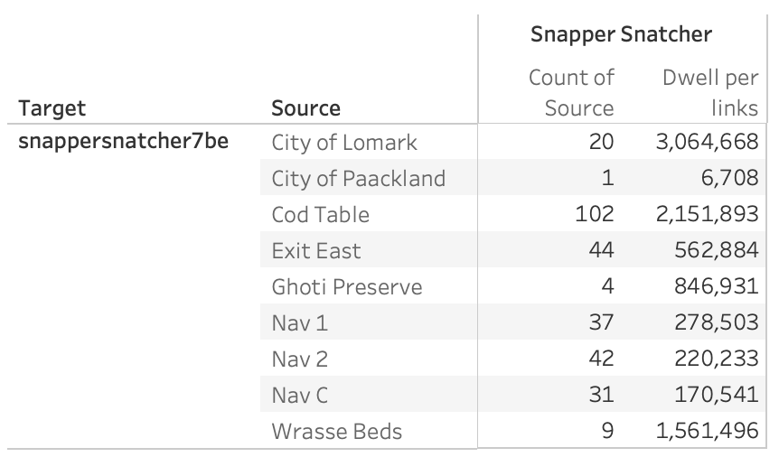
SOUTHSEAFOOD EXPRESS CORP’S VESSELS

Slide 20
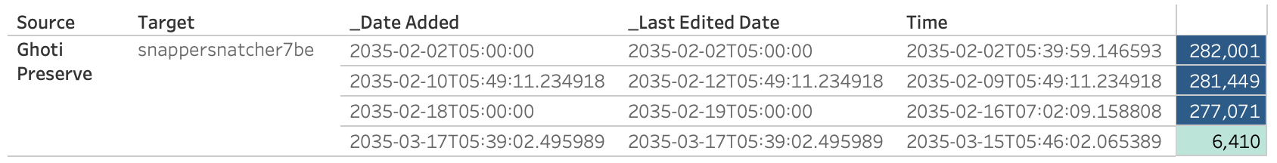
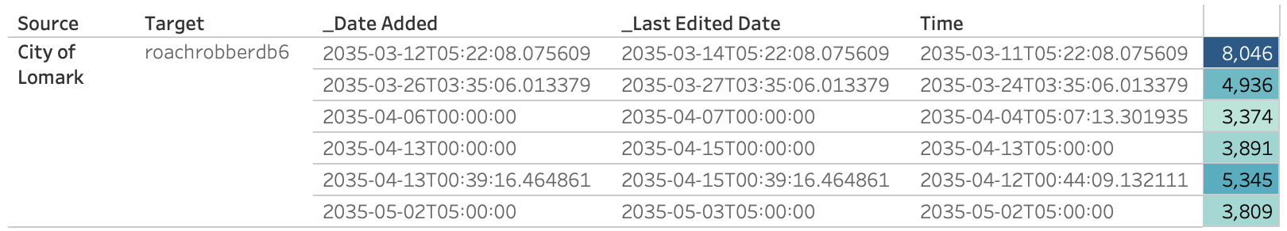
A DEMONSTRATION OF 2 VESSELS

Slide 21
Thank you for listening
Do you have any questions?

